Slide 1
PEDESTRIAN SAFETY
Presented by
Somanath Khot
Assistant Professor,
Department of Civil Engineering,
KLS GIT, Belagavi.

Slide 2
Content:
Pedestrian - who?
Pedestrian Safety
Observations on Indian Roads
Design guidelines
Best Practices

Slide 3
Pedestrian – Who?
Design of Pedestrian Facilities
3
Every person living on earth – a pedestrian
The World Health Organization (WHO, 2013) defines “A pedestrian is any person who is travelling by walking for at least part of his or her journey.
Various modifications and aids to walking such as wheelchairs, walkers, canes, skateboards, and roller blades.
The person may carry items of varying quantities, held in hands, strapped on the back, placed on the head, balanced on shoulders, or pushed/pulled along.
A person is also considered a pedestrian when running, jogging, hiking, or when sitting or lying down in the roadway.

Slide 4

Pedestrian – Who?
Design of Pedestrian Facilities
4
A favourable environment for pedestrians would mean a favourable environment for ALL.
Street design has to answer inclusivity and accessibility for ALL
Walking is slowest of all other modes of transport, this slow pace has a lot of advantage as at this pace we can see distinguish between people, feel and understand the environment nearby.

Slide 5
Pedestrian – Who?
Design of Pedestrian Facilities
5
In order to serve the above requirements and make walking a pleasurable experience there are 3 basic principles
Coherence and directness,
Attractiveness & comfort
Safety & security
Walking is the basis of human movement, it is while walking we observe, connect, interact and learn
The benefits of walking can be classified into Economic, Environmental, Social and Health benefits, all of these benefits lead to a better quality of life for people

Slide 6
WHY PEDESTRIAN SAFETY?
Urban sprawl has often left pedestrians stranded. Wide roads have been built without sidewalks or frequent crosswalks, and high-speed traffic makes these roadways particularly deadly.
In many areas, intersections with crosswalks may be as much as a kilometer apart, leaving pedestrians with no safe way to cross the street.

Slide 7
Background - safety
Design of Pedestrian Facilities
6
Road accidents are a leading cause of death of young people between the age group of 10 – 24 years.(WHO)
In the year 2018 more than 2,00,000 people died in road crashes in India while the number of injured were about 5,43,000.
However, the actual number of injuries requiring hospital visits were 20,00,000 to 30,00,000
On average 40% of the total fatalities are pedestrian fatalities.

Slide 8
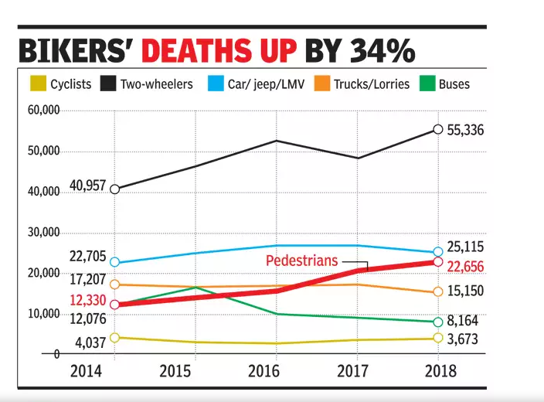

Slide 9
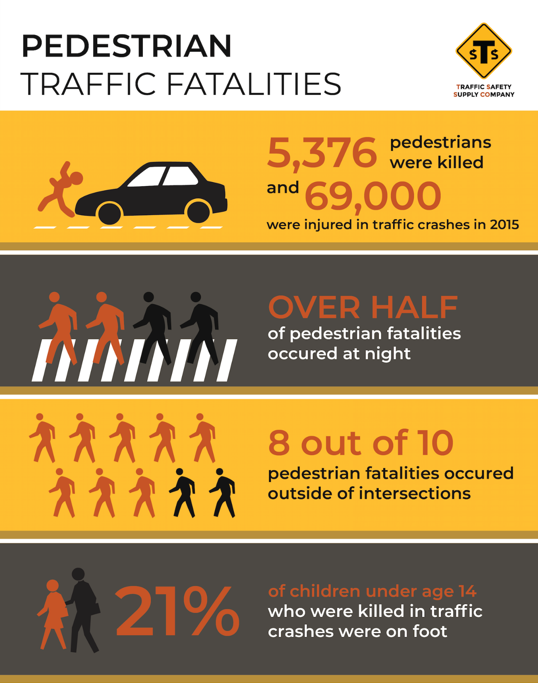

Slide 10
Who’s Failure lead to an Accident
80%
78%
60%
40%
20%
14%
1%
3%
2%
1%
1%
0%
Cyclist
%age
Driver
Pedestrian
MotorCycle Road Condition
Weather
Others
Traffic Fatalities by Road User
80
60
40
20
0
Motorcycle
Mumbai
Pedestrian Delhi
Truck
Bus
Car
Taxi
Bicycle

Slide 11
350000
Pedestrian accidents make up
11%
Every Year
Pedestrians were killed in motor vehicle accidents Between 1975 and 2018
Of all motor vehicle accidents
5000
pedestrians are killed
84000
60%
88%
pedestrians are injured
Of accidents occurred in Place where no crosswalks
of accidents occurred in normal weather condition
64%
of accidents occurred at night

Slide 12




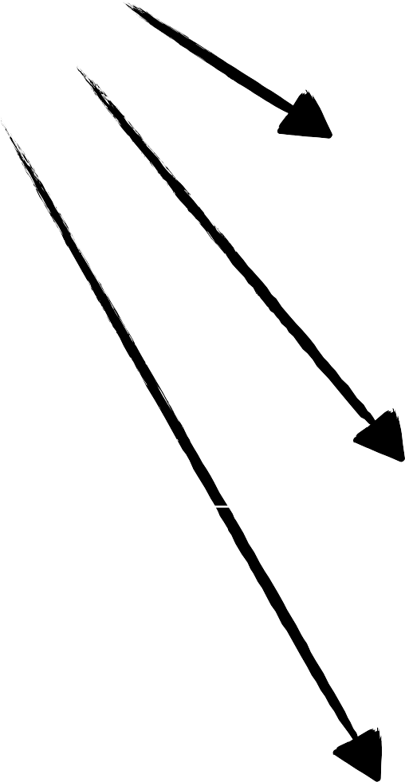




Crash: Causes & Prevention
Prevention
Physical Roadway
Inefficient Driver
Poor Operating Policies
Defective Vehicle
Lack of Education
Good engineering can reduce the effects of ...
Bad Environment
Inadequate Enforcement

Slide 13
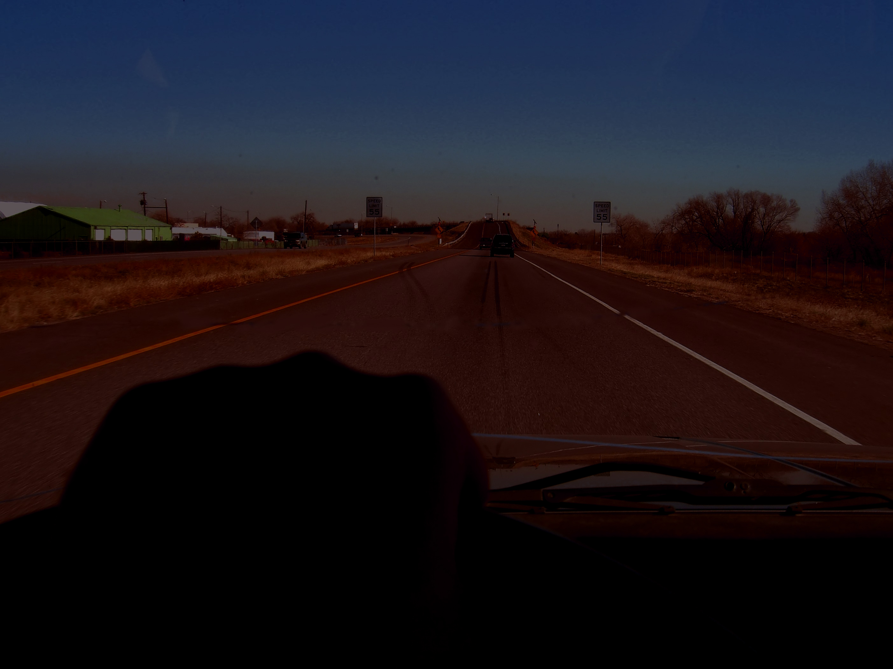
Pedestrian crashes typically occur during the late afternoon and early evening hours presumably because of the reduced levels of
visibility at a time when many people are on the road.

Slide 14
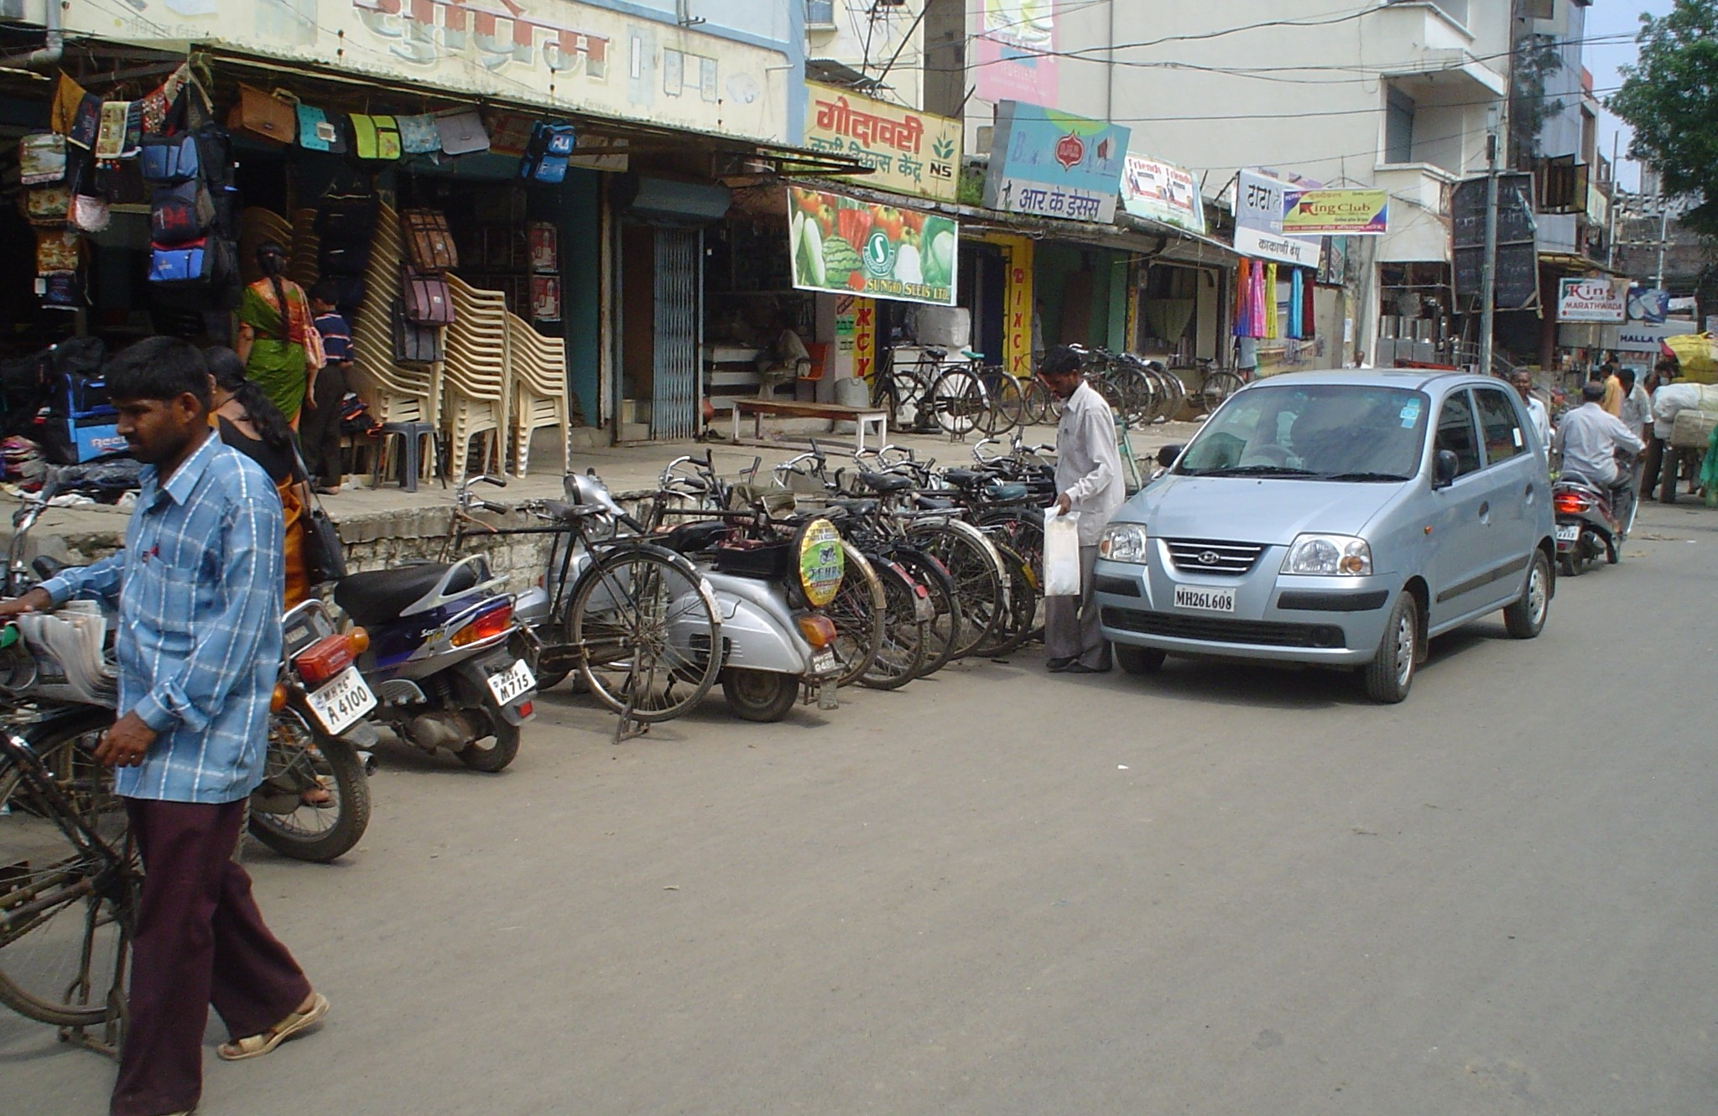
Some observations on Indian Roads Current conditions
ON ROAD PARKING
30-40% of city roads are occupied with parking at any point of time

Slide 15
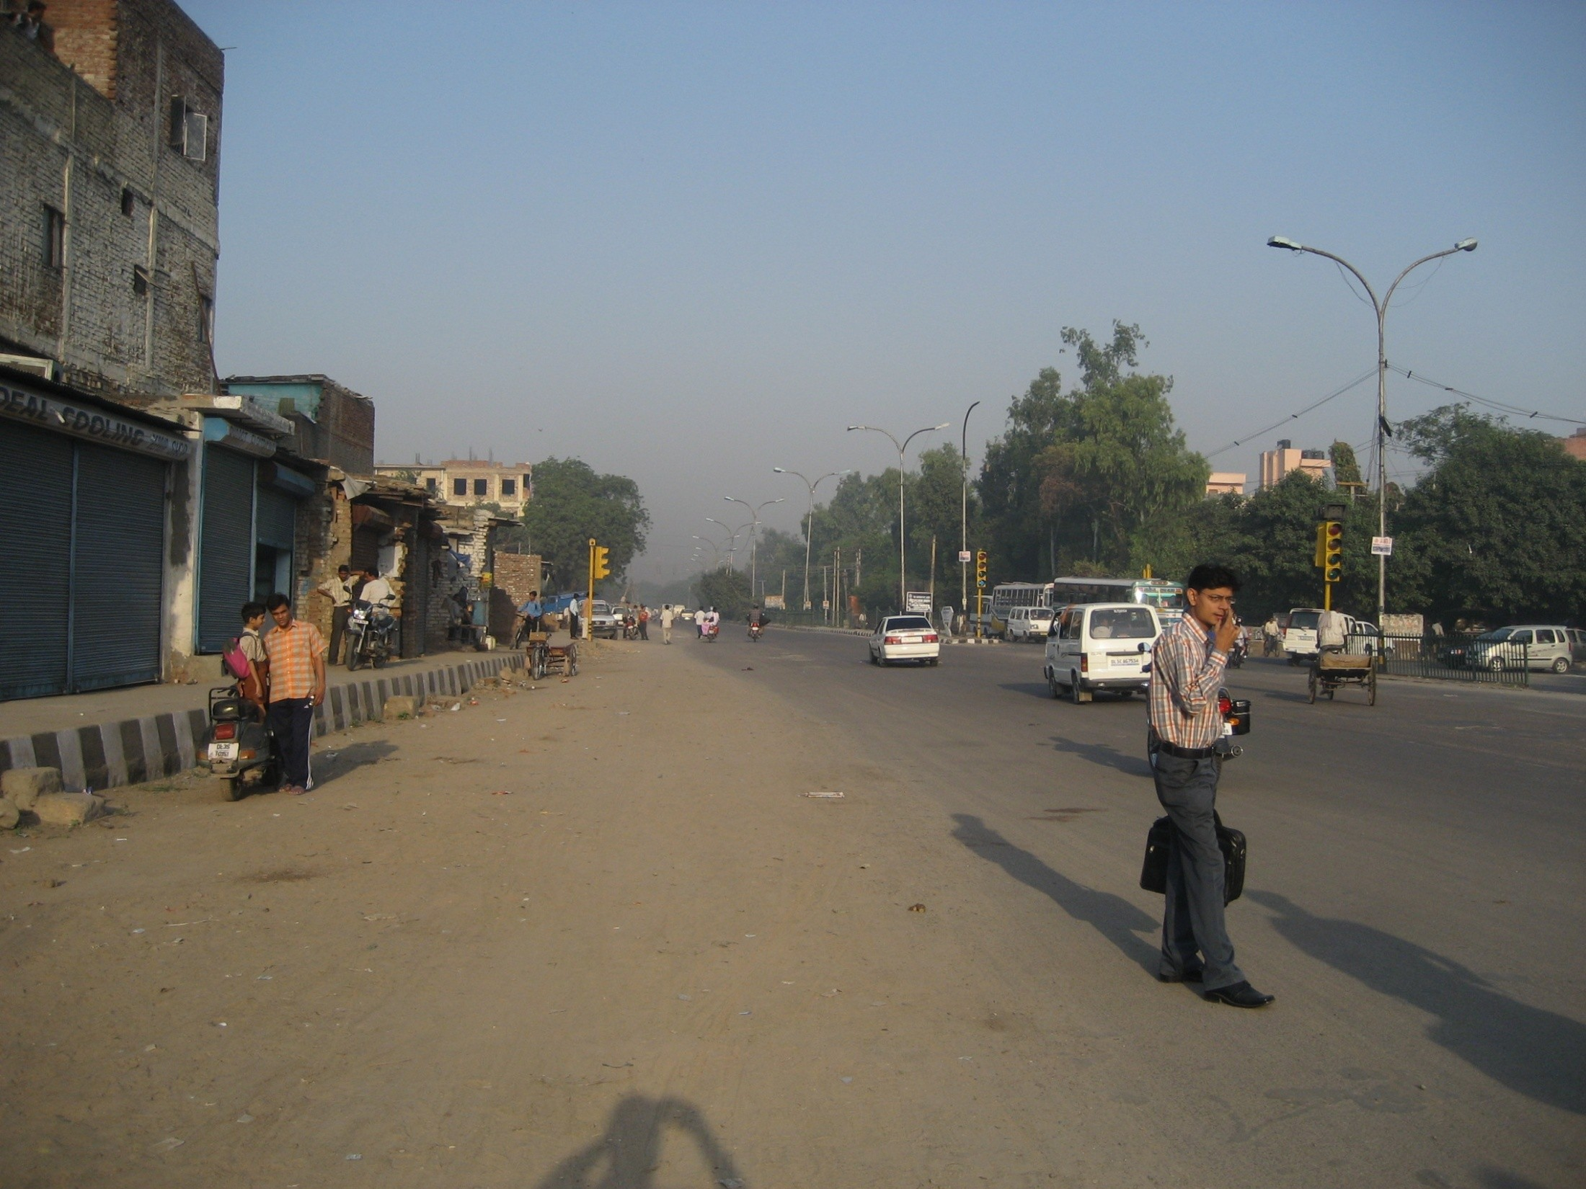
Current conditions
road width
Walkway width _{= ??}
Road width
street lighting, trees etc. are missing

Slide 16
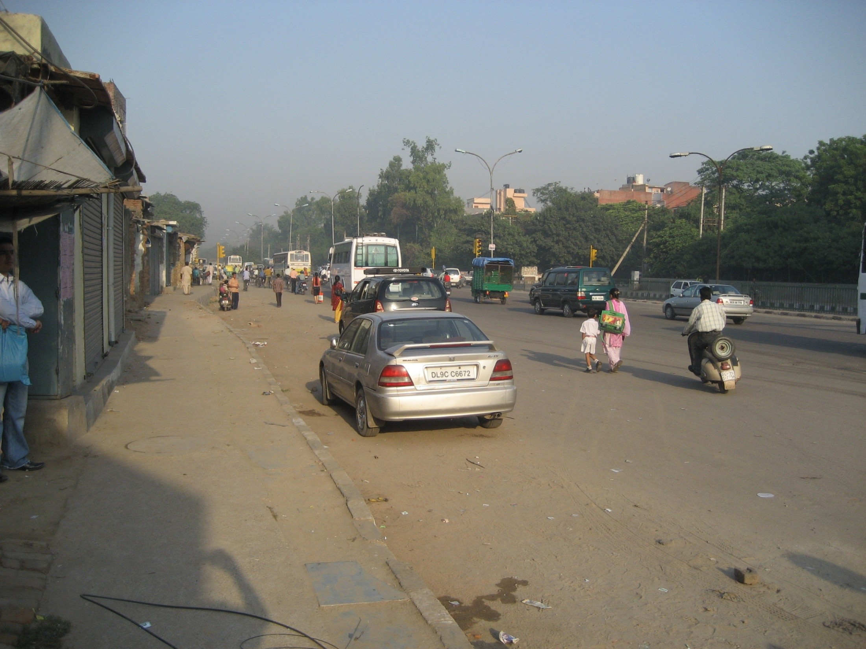
Current conditions
In-appropriate design of road cross sections- designed for nobody

Slide 17
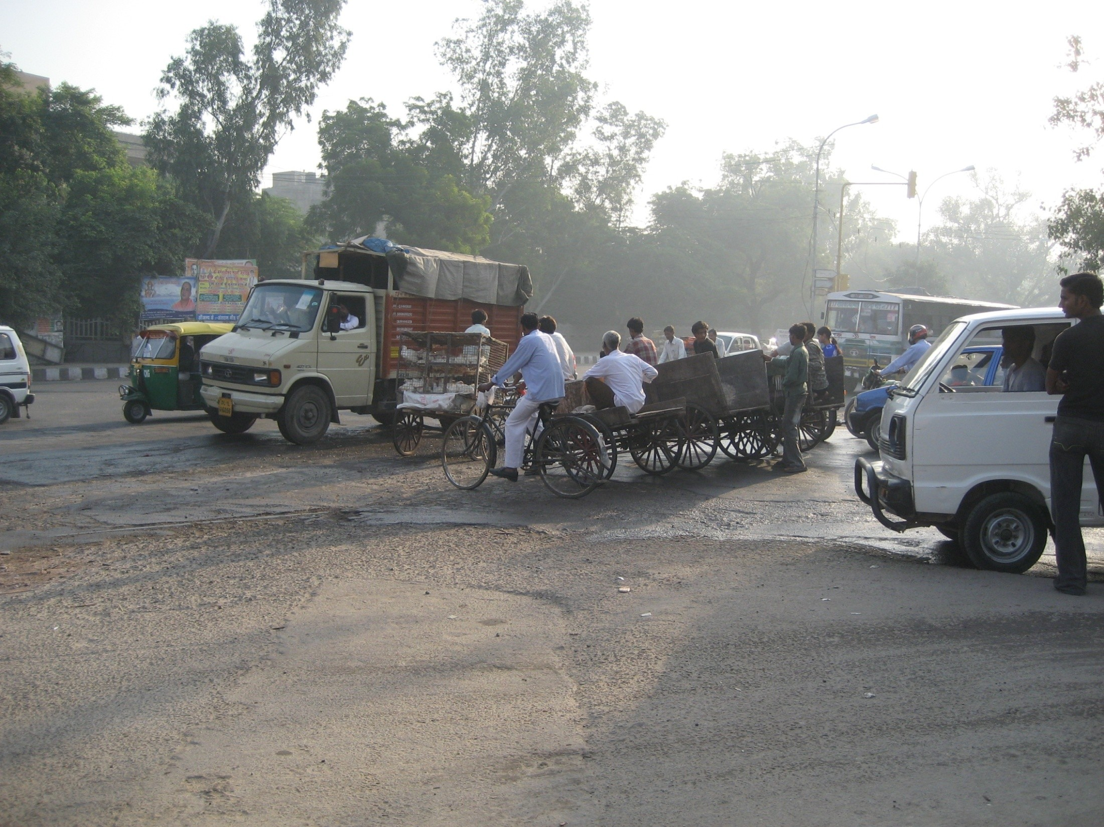
Current conditions
No designs at junctions- resulting in traffic bottlenecks and safety compromises

Slide 18
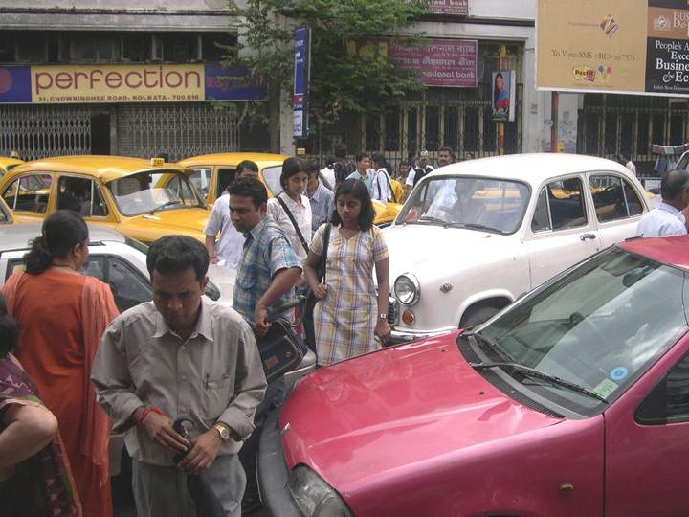
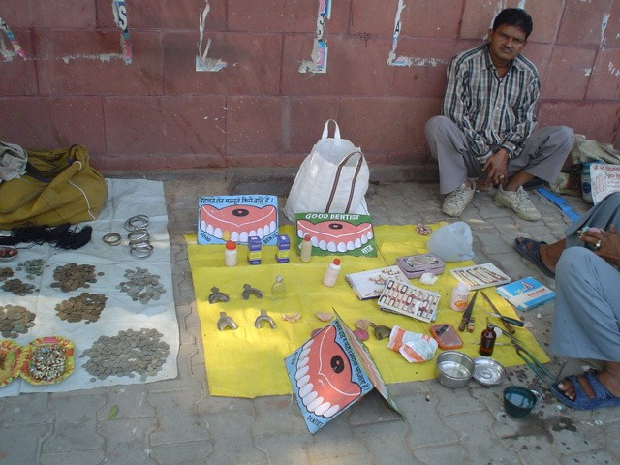
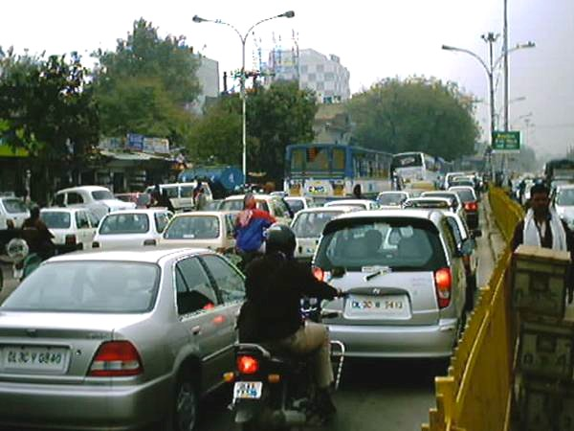
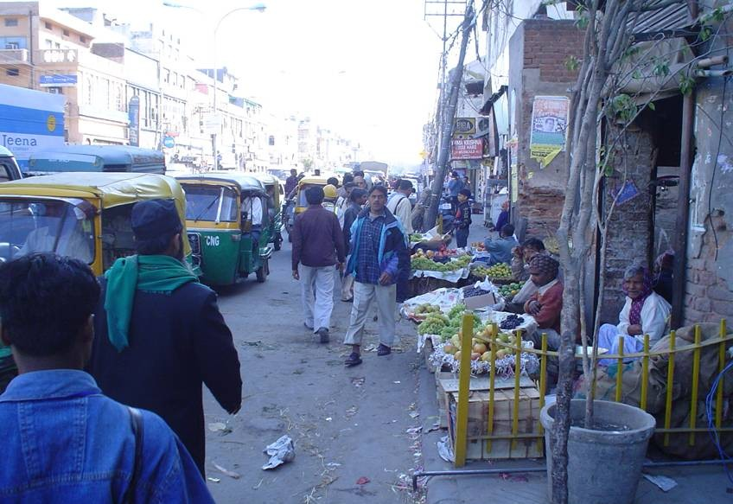
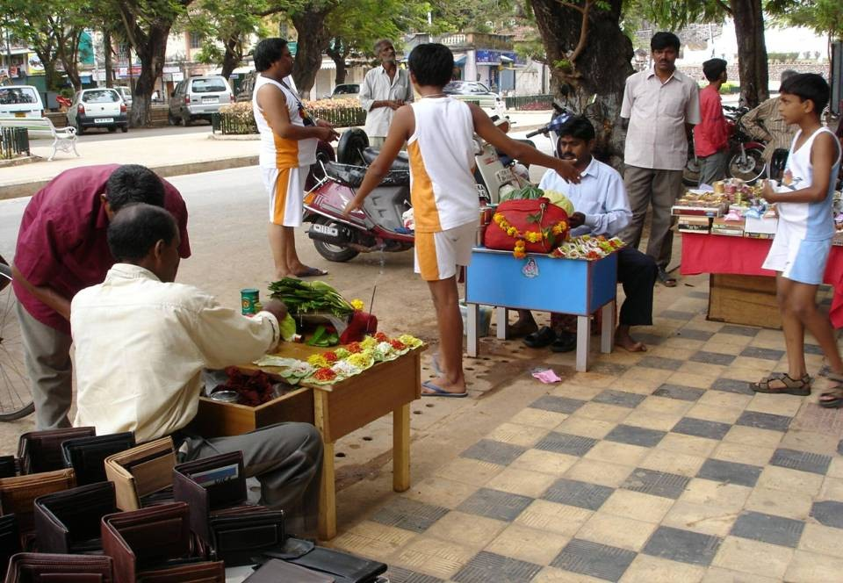
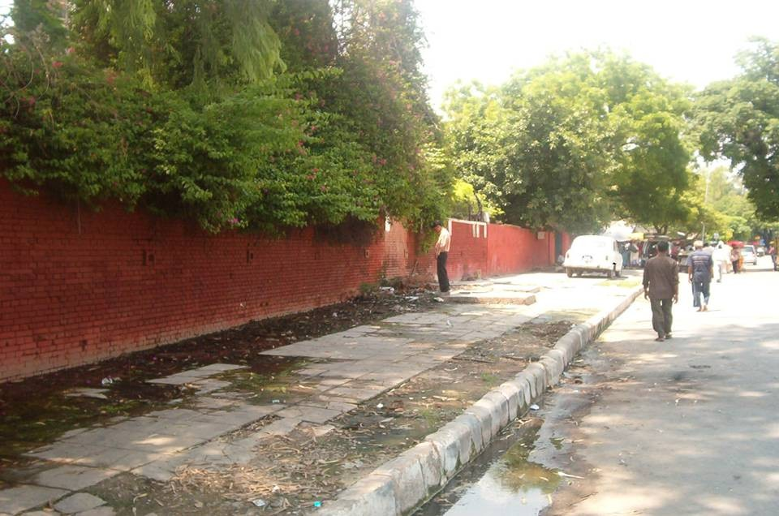
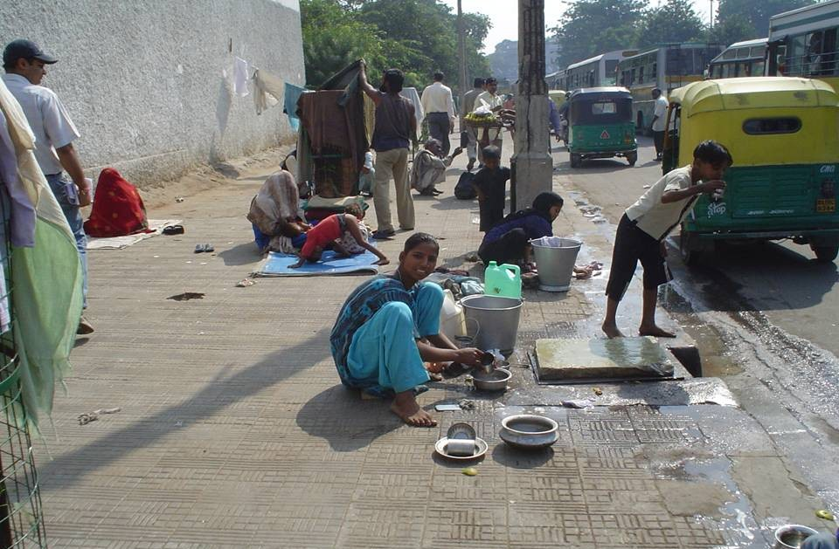
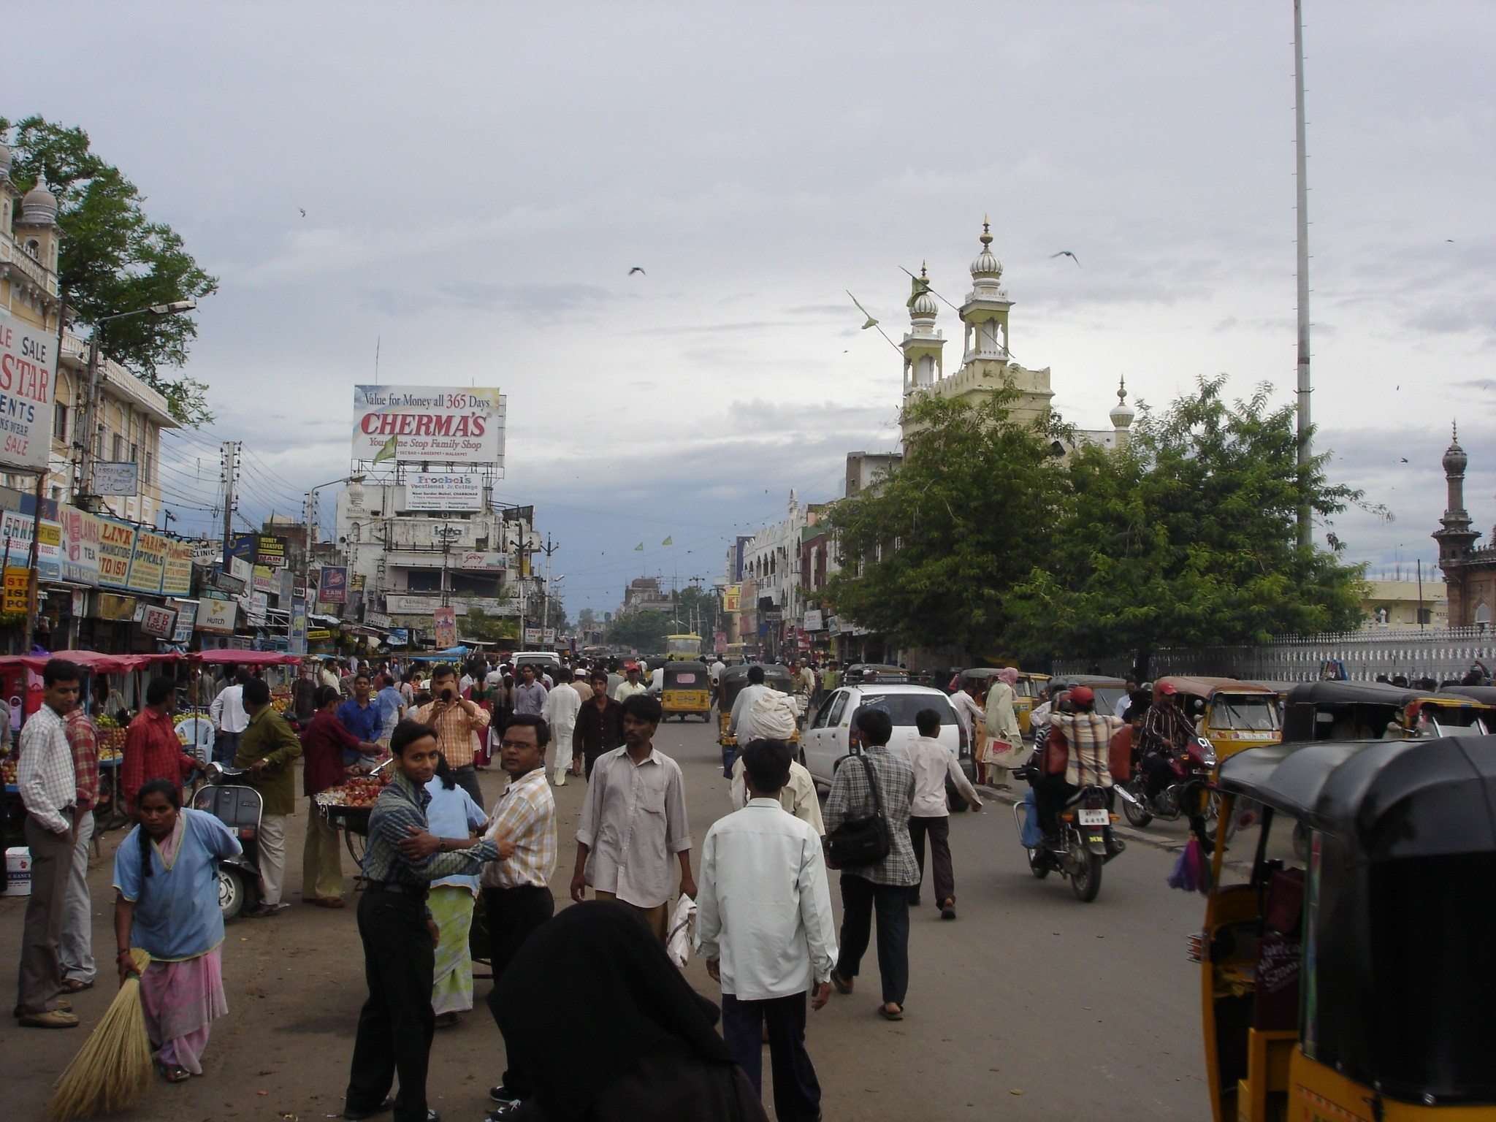
“equitable space allocation for all road users with a focus on people rather than vehicles.”

Slide 19
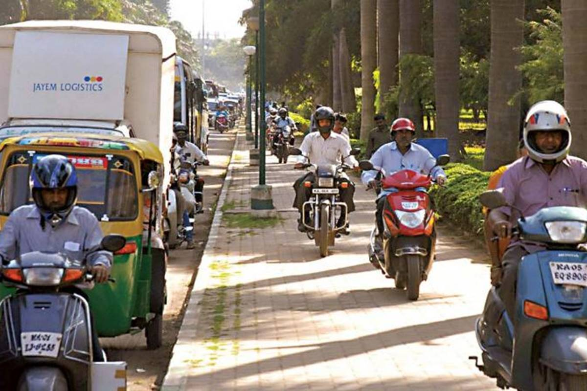
Current conditions

Slide 20
Lady crossing the road
Lady Crossing Road Causes Fatal Road Accident _ Foolish

Slide 21
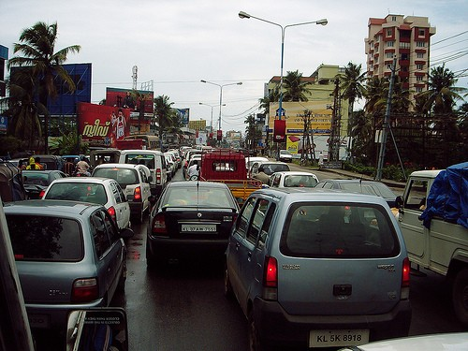
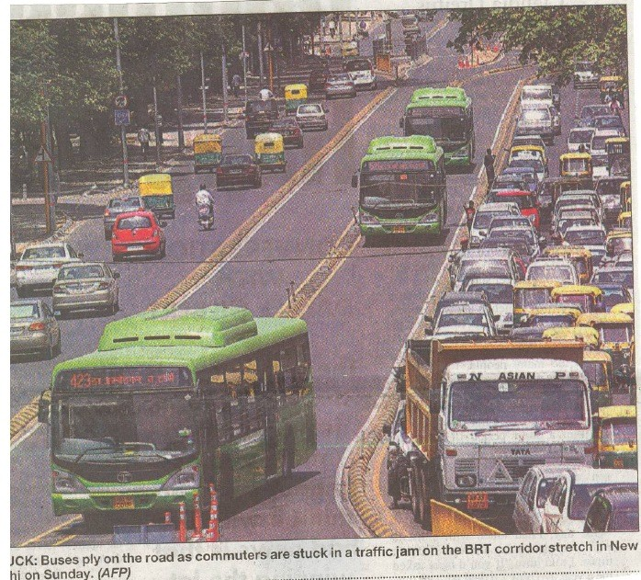
BANGALORE
Rush Hour (on a 10m wide road)
Congestion??
Bike (1 PAX)
Car (1 PAX)
Bus (70 PAX)
1 KM of this road (No Buses)
Approx. 300 cars & Bikes
This reduces to only few buses if public transit to be used
But public transit itself is in poor condition

Slide 22
ACCIDENTS (BANGALORE)
15000
11250
9662
Fatal
Non-Fatal
8226
7469
7500
6782
6681
6908
6138
5667
5297
4767
3750
3052
843
875
796
880
957
864
737
816
727
735
0
487
2003 2004 2005 2006 2007 2008 2009 2010 2011 2012 2013 (mid)

Slide 23
Why Pedestrian Crossings Don’t Matter In India

Slide 24
MITIGATION PLANS FOR PEDESTRAIN SAFETY
Safe infrastructure (walkways, over/under-pass etc)
Behavioral Issues (Traffic signs, Fines, Education, Culture)
Safety engineering (Optimum speed, designs etc.)

Slide 25
Infrastructure for Pedestrian
Design of Pedestrian Facilities
9
Off-street facilities - Walkways
On-street Sidewalks/Footpath
Crosswalks
Un-signalized
Signalized
Mid-block

Slide 28
Guard Rails

Slide 37
Footpaths
Design of Pedestrian Facilities
10
A footpath is the part of road or other public place that is laid out or built for pedestrian use.
Footpaths may run alongside the road or through parks and other open spaces, and include overbridges and subways.
Footways are those parts of access roads which are intended for use by pedestrians, and which generally are parallel with the carriageways and separated by curb.
Footpaths are those pedestrian routes which are located away from carriageways and not associated with routes of motor vehicles.

Slide 38
Policy and design guidelines - India
Design of Pedestrian Facilities
11
National Urban Transport Policy (NUTP), 2006
National Mission on Sustainable Habitat (NMSH)
IRC Guidelines addressing pedestrians
IRC: 103-2012 - Guidelines for pedestrian facilities
Institute for Transportation and Development Policy (ITDP), 2013

Slide 39
Footpaths – Design goals
Design of Pedestrian Facilities
39
Provide footpaths wherever pedestrians will use them
Use footpath dimensions and geometry that provides access for all
Choose surface materials for safety, convenience and aesthetics
Manage design and location of street furniture
Locate and design driveways appropriately
Manage conflict on shared paths by good design and operation
Provide quality connections to public transport

Slide 40
Footpaths – Design elements
Design of Pedestrian Facilities
40
Where to provide footpaths
Widths
Overhead and protrusion clearances
Gradient
Crossfall
Surfaces
Grates and covers
Landscaping
Street furniture
Ramps and steps
Driveways
Shared paths
Public transport interface

Slide 41
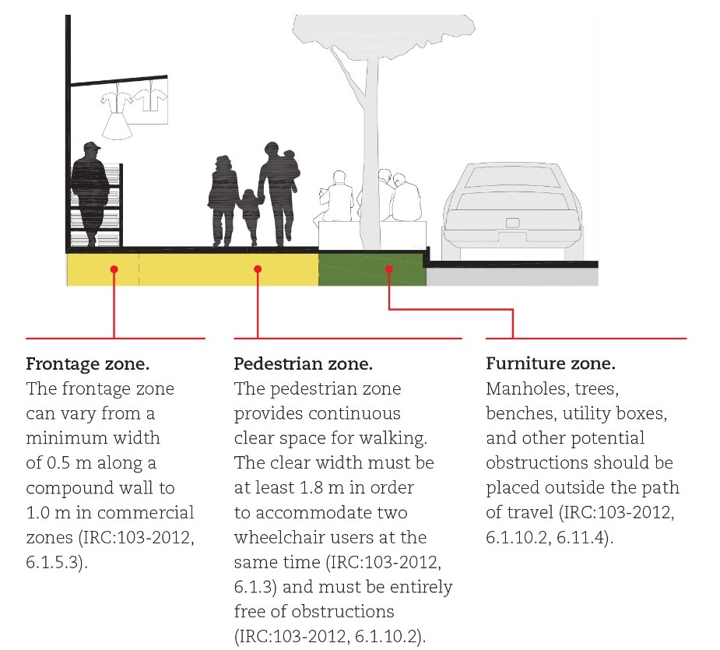
Footpath standards (IRC 103-2012)
Design of Pedestrian Facilities
13

Slide 42
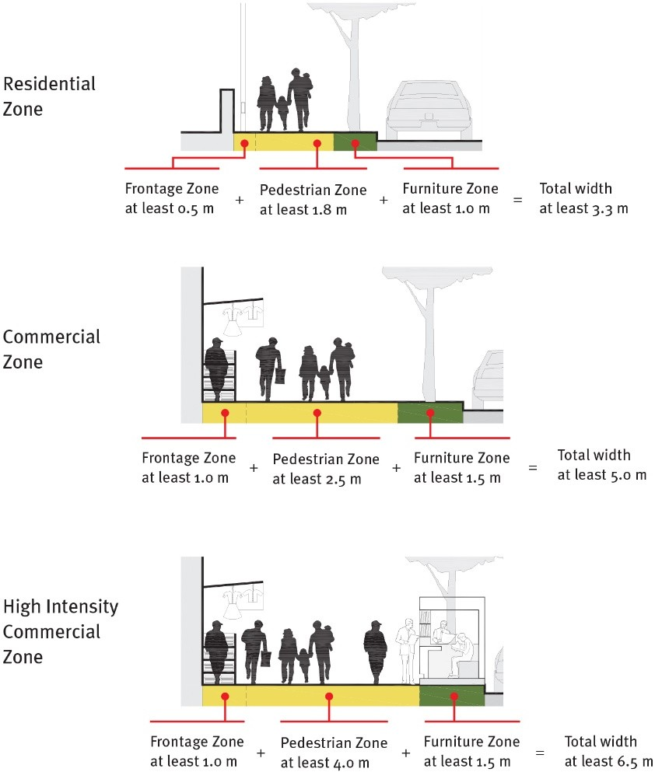
Footpath standards (IRC 103-2012)
Design of Pedestrian Facilities
14

Slide 43
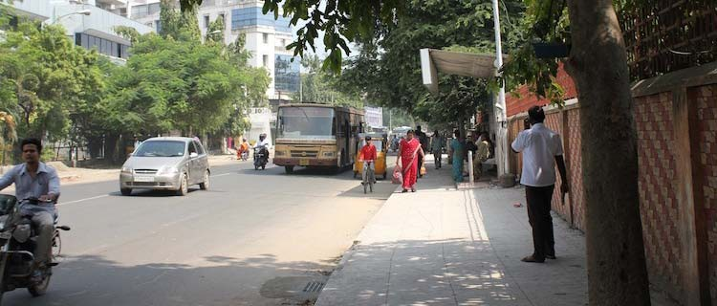
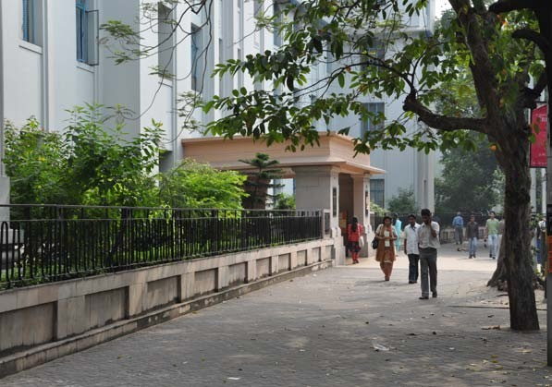
Footpath standards (IRC 103-2012)
Design of Pedestrian Facilities
15
Footpaths are designed for level of service B and level service C (under resource constraint)
The width of the footpath should be designed based on expected pedestrian traffic
Side Design flow in number of pedestrians/hour ^{walk} In both directions In one direction width (m) LOS B LOS C LOS B LOS C
1.5 | 1350 | 1890 | 2025 | 2835
2.0 | 1800 | 2520 | 2700 | 3780
2.5 | 2250 | 3150 | 3325 | 4725
3.0 | 2700 | 3780 | 4050 | 5670
3.5 | 3150 | 4410 | 4725 | 6615
4.0 | 3600 | 5040 | 5400 | 7560

Slide 44
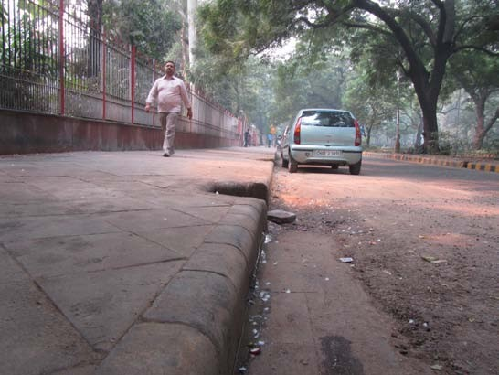
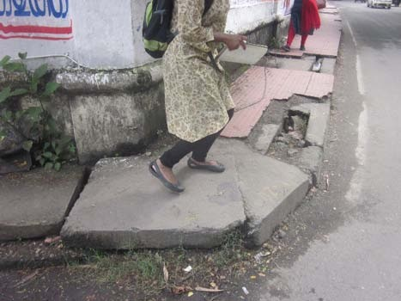
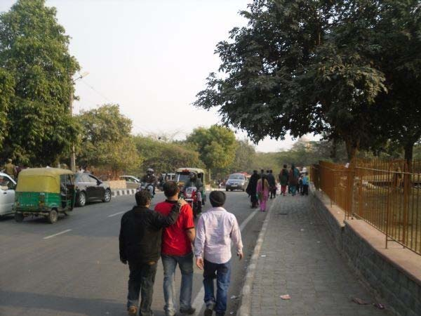
Design of Pedestrian Facilities
17
Footpath standards (IRC 103-2012) - Kerb height
and surface quality
Kerb height should not exceed 150 mm
Even paved surfaces are important to people using sticks and wheel chairs
The gap between paving slabs should not exceed 5 mm

Slide 45
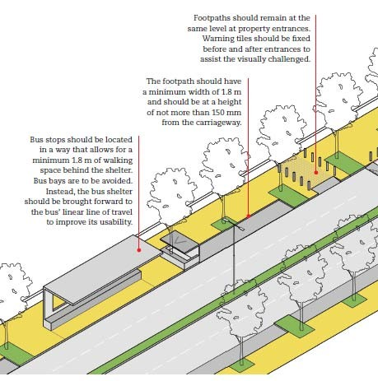
Footpath standards (IRC 103-2012)
Design of Pedestrian Facilities
18
Footpaths should provide continuous space for walking of pedestrians
Bus stops, services, vendors, access to several types of properties, cross walks etc. are common on footpath
Well use of a footpath depends on successful integration of different footpath elements

Slide 46
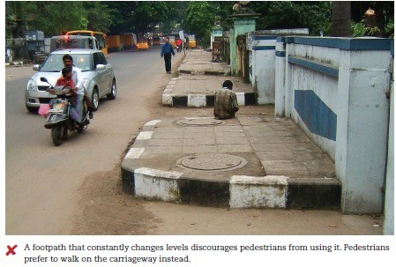
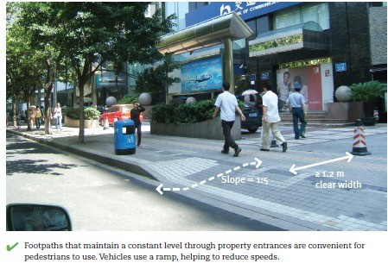
Design of Pedestrian Facilities
20
Access to properties (IRC 103-2012)

Slide 47
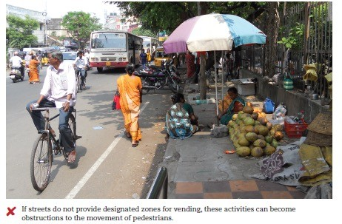
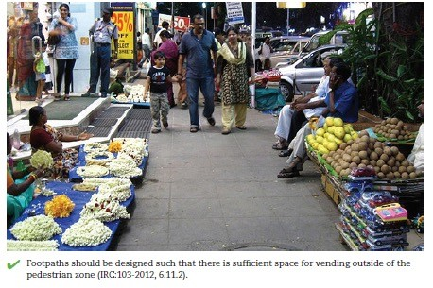
Design of Pedestrian Facilities
21
Street Vending

Slide 48
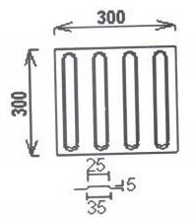
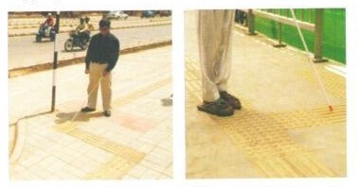
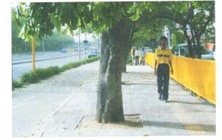
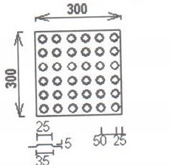
Tactile pavers (IRC 103-2012)
Design of Pedestrian Facilities
23
To guide the pedestrians with vision impairment
It is important that, whichever tactile pavers are
used for guiding or warning, they should be
used consistently used to avoid confusion.
Guide blocks indicate the correct route to follow , bus stops, property etc.
Configuration of floor tactile paving
tactile paving to avoid obstacles
warning blocks to screen off the obstacles

Slide 49
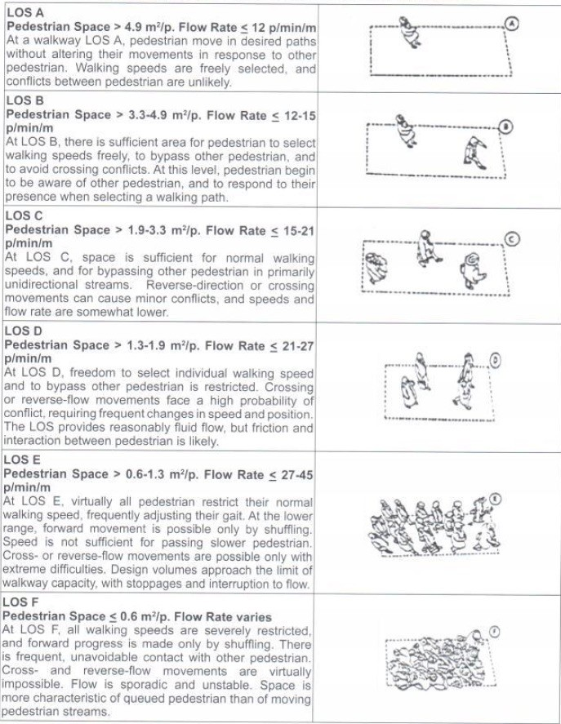
Level of service
Design of Pedestrian Facilities
25

Slide 50
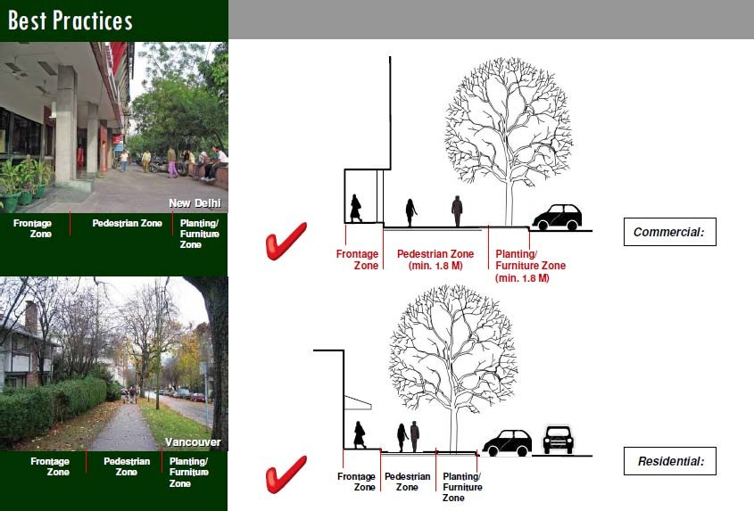
Best practices
Design of Pedestrian Facilities
47

Slide 51
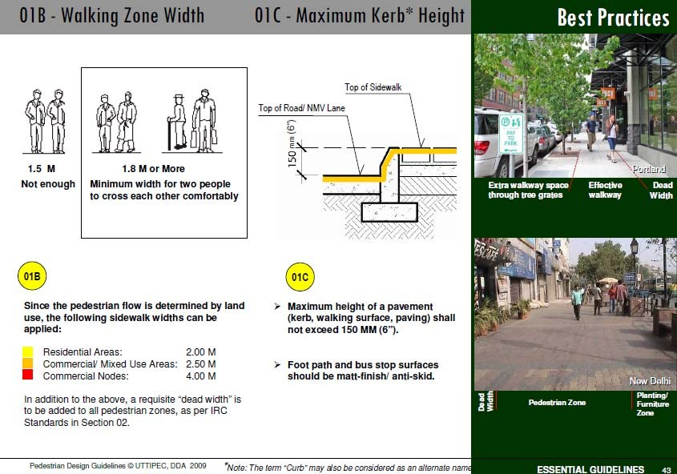
Best practices
Design of Pedestrian Facilities
48

Slide 52
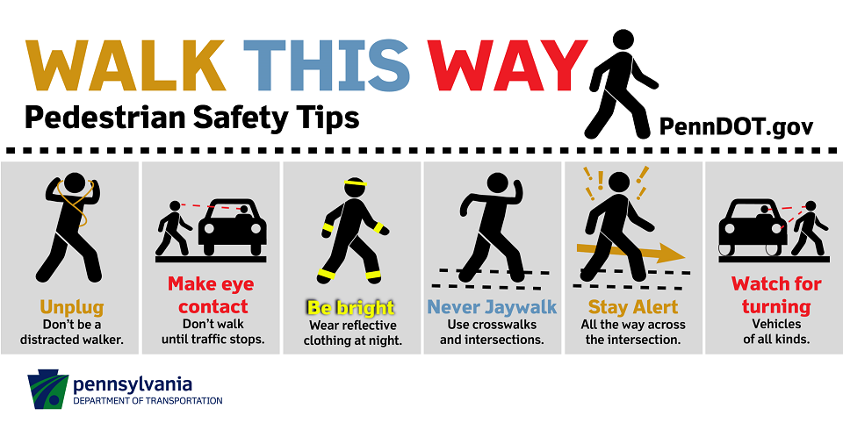
Not This Way- Problem with Todays era of Technology???

Slide 53
Case Study: Improvising a Junction for Pedestrian Movements in Mumbai Designing Streets like Pedestrians Matter_ HP Junction, Mumbai

Slide 54
References:
IRC:103-2012 Guidelines for pedestrian facilities
PEDESTRIAN SAFETY–DESIGN by K Ramachandra Rao, Department of Civil Engineering and Transportation Research and Injury Prevention Program (TRIPP) Indian Institute of Technology, Delhi
PEDESTRIAN SAFETY by Ashish Samdariya and Achuth Vasudevan
Indian Express News Database

Slide 55
Thank you
Design of Pedestrian Facilities
53

